Slide 1


Open Enrollment
Blue Valley School District
Delta Dental of Kansas Benefits
Notes:
1

Slide 2


YOUR DENTAL BENEFITS
Blue Valley School District offers benefit eligible employees two dental plans to choose from.
The following slides will detail the two plans, referred to as the Base Plan Option and the Buy Up Plan Option. Delta Dental Premier®
Notes:
2

Slide 3



Your Plan Type and Dentist Network
Plan Type: Delta Dental PPOTM
Dentist Network: Delta Dental PPOTM & Delta Dental Premier®
You have access to both our nationwide networks with your plan, however your plan has higher coverage, and greater savings for you, when visiting a Delta Dental PPO network dentist.
You can easily search for an in-network dentist by using the online dentist search at DeltaDentalKS.com.
Notes:
3

Slide 4
Your Delta Dental of Kansas Benefits Overview – Base Plan
Your Dental Network
Delta Dental PPO & Premier
Annual Maximum Benefit (per person, per calendar year)
$1,500
Deductible (per calendar year, diagnostic and preventive services are NOT subject to deductible)
$50 per person, $150 max
Eligible Children Ages (dependent children are eligible for coverage)
To end of the year in which the dependent turns 26
Ortho Lifetime Maximum
(per dependent child)
$1,000
This is a summary of benefits only and does not bind Delta Dental of Kansas to any coverage. Please see your Benefit Booklet for full coverage details, exclusions and limitations.

Slide 5
Your Delta Dental of Kansas Benefits Overview – Base Plan
Delta Dental PPO Network Coverage
Diagnostic & Preventive Services (exams, cleanings, x-rays, etc.; NOT subject to the deductible)
100%
Basic Services (cavity fillings, emergency exam, oral surgery, periodontics, etc.)
80%
Major Services* (crowns, bridges, dentures, occlusal guards, etc.)
50%
Orthodontics* (orthodontic appliances and treatment for dependent children age 19 and under)
50%
*All Major and Orthodontic Services are subject to a twelve (12) month waiting period.
This is a summary of benefits only and does not bind Delta Dental of Kansas to any coverage. Please see your Benefit Booklet for full coverage details, exclusions and limitations.

Slide 6
Your Delta Dental of Kansas Benefits Overview – Buy up Plan
Your Dental Network
Delta Dental PPO & Premier
Annual Maximum Benefit (per person, per calendar year)
$1,700
Deductible (per calendar year, diagnostic and preventive services are NOT subject to deductible)
$50 per person, $150 max
Eligible Children Ages (dependent children are eligible for coverage)
To end of the year in which the dependent turns 26
Ortho Lifetime Maximum (per person)
$1,500
This is a summary of benefits only and does not bind Delta Dental of Kansas to any coverage. Please see your Benefit Booklet for full coverage details, exclusions and limitations.

Slide 7
Your Delta Dental of Kansas Benefits Overview – Buy up Plan
Delta Dental PPO Network Coverage
Diagnostic & Preventive Services (exams, cleanings, x-rays, etc.; NOT subject to the deductible or the annual maximum)
100%
Basic Services (cavity fillings, emergency exam, oral surgery, periodontics, etc.)
80%
Major Services* (crowns, bridges, dentures, occlusal guards, etc.)
50%
Orthodontics* (orthodontic appliances and treatment for adults and dependent children through age 26)
50%
*All Major and Orthodontic Services are subject to a twelve (12) month waiting period.
This is a summary of benefits only and does not bind Delta Dental of Kansas to any coverage. Please see your Benefit Booklet for full coverage details, exclusions and limitations.
Notes:
Edit and confirm red text – then change text color to black.
Delete Orthodontics if it doesn’t apply to group’s plan.

Slide 8
Your Delta Dental of Kansas Benefits Overview
Right Start 4 Kids Program (RS4K)
Both the Base and Buy Up plan have RS4K:
100% coverage for kids 12 & under for all covered services under the plan, excluding orthodontics.
Must see an in-network dentist – RS4K will only apply when visiting a Delta Dental PPO or Delta Dental Premier dentist. If an out-of-network dentist is seen, then the underlying contract applies including waiting periods, deductibles and coinsurance levels.
Covered services under RS4K are not subject to the plan’s deductible or waiting periods.
Covered services under RS4K are subject to plan’s annual maximum.
This is a summary of benefits only and does not bind Delta Dental of Kansas to any coverage. Please see your Benefit Booklet for full coverage details, exclusions and limitations.

Slide 9
Your Delta Dental of Kansas Benefits Overview
Unlimited Cleanings Program
Both the Base and Buy Up plan have Unlimited Cleanings:
The Unlimited Cleanings Program allows coverage for both regular cleanings and periodontal cleanings at an unlimited frequency. Services that apply to this program:
    Prophylaxis (regular/routine teeth cleaning) for adults and children. (D1110 & D1120)
    Periodontal Maintenance (or periodontal cleaning), a more extensive teeth cleaning performed when an individual has history of non-surgical or surgical periodontal treatment. (D4910)
Your underlying contract applies with the exception of the frequency limitations on the services listed above.
Cleanings are subject to the plan’s annual maximum under the Base Plan.
This is a summary of benefits only and does not bind Delta Dental of Kansas to any coverage. Please see your Benefit Booklet for full coverage details, exclusions and limitations.

Slide 10
MEMBER TOOLS
Notes:
10

Slide 11
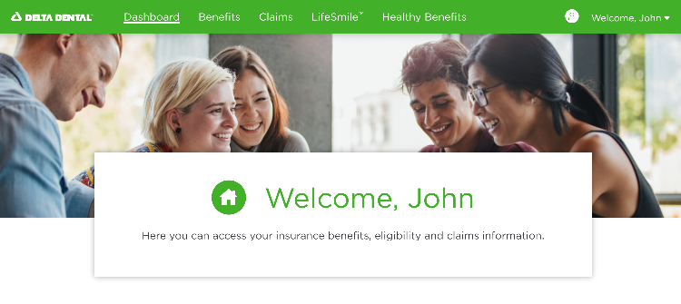
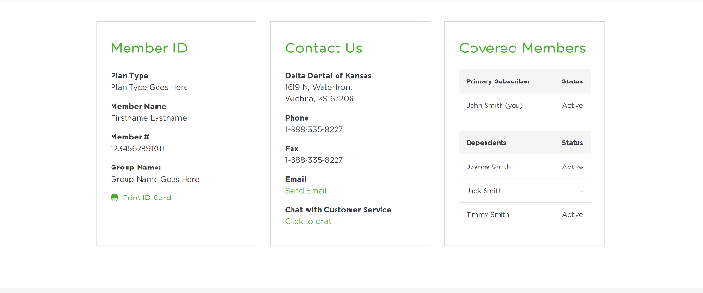
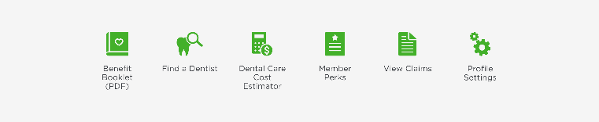
Online Member Account
You can manage your dental benefits online through your member account. Easily log in or register at DeltaDentalKS.com/Member
View and print ID cards
View your benefits & eligibility, claims and EOBs
Consent to receive electronic communications
Estimate your out-of-pocket costs
Track your dental cleanings
And more!
Notes:
11

Slide 12



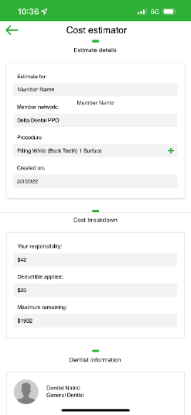


Mobile App
With Delta Dental’s mobile app you can:
Use your mobile ID card
Find a dentist
Use the Dental Care Cost Estimator*
Check coverage and claims
And more!
*The Dental Care Cost Estimator provides an estimate and does not guarantee the exact fees for dental procedures, what dental benefits plan will cover or your out-of-pocket costs. Estimates should not be construed as financial or medical advice. For more detailed information on your actual dental care costs, please consult your dentist and call Delta Dental of Kansas at 800.234.3375.
Notes:
12

Slide 13
Thank you!
Notes:
13

