Slide 1


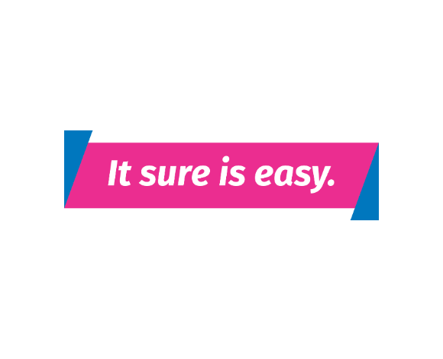
Blue Valley School District Surency Vision Benefits
Open Enrollment
Surency.com
Notes:
1

Slide 2
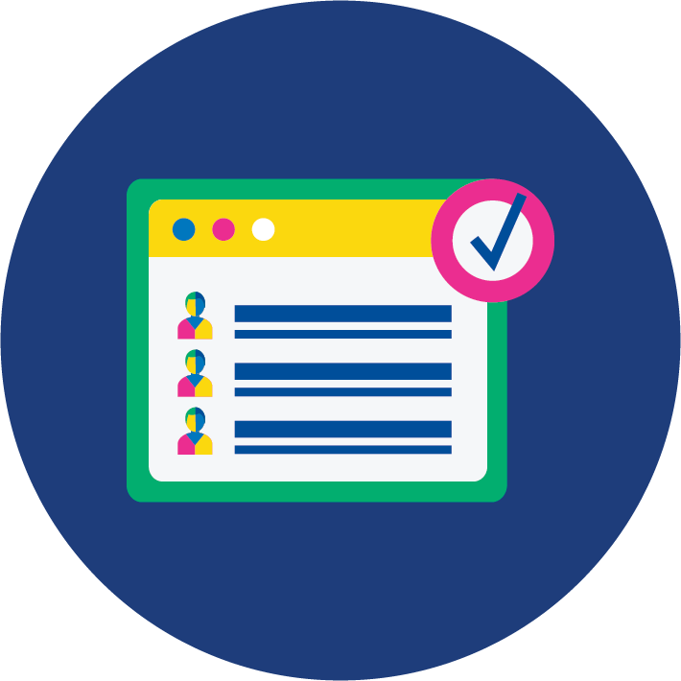


Your Network
Surency Vision Provider Network: Access Network
You can easily search for an in-network vision provider by using the online provider search at Surency.com.
Choose “Access Network” to begin your search.
Notes:
2

Slide 3



Your Network
Surency Vision is proud to offer a large, diverse network with retail chains and independent private practitioners that offer quality, convenience, and choice.
You can also order glasses or contacts online using your in-network benefits.
Notes:
3

Slide 4

Your Benefits Overview
Your Vision Network
Access network
Eye Exam (once every calendar year)
$10 Copay
Frames Allowance (once every 2 calendar years)
$130
Contact Lens Allowance (once every calendar year) (In lieu of eyeglass lenses)
$130
Contact Lens Fit and Follow-up (standard)
$0 Copay
This is a summary of benefits only and does not bind Surency to any coverage. For additional plan information, review you Summary of Benefits.

Slide 5
Your Benefits Overview
Standard Plastic Lenses (once every calendar year)
Single Vision
$25 Copay
Bifocal
$25 Copay
Trifocal
$25 Copay
Lenticular
$25 Copay
This is a summary of benefits only and does not bind Surency to any coverage. For additional plan information, review you Summary of Benefits.

Slide 6
Your Benefits Overview
Lens Options (once every calendar year)
Standard Polycarbonate
Adults: $40 Copay
UV Coating
$15 Copay
Tint (solid and gradient)
$15 Copay
Standard Scratch-Resistant
$15 Copay
This is a summary of benefits only and does not bind Surency to any coverage. For more information on Lens Options available to you, review your Summary of Benefits.

Slide 7

Your Member Perks
Member Perks/Additional Savings with Your Surency Vision Plan:
40% off additional pair of prescription eyeglasses or sunglasses
20% off non-covered items such as cleaning cloths and solution
15% off LASIK retail, 5% off LASIK promotion
Learn more at Surency.com

Slide 8

Member Tools
Notes:
8

Slide 9



Mobile App
Access your benefits from anywhere with the Surency Vision Mobile App.
Access the Information You Need:
  Find an in-network provider near you.
  Use your mobile ID card at your next eye exam.
  View your benefits, eligibility and claims.
  Order replacement contacts at ContactsDirect.com, and purchase glasses at Glasses.com. Enter your Surency Vision insurance information on both websites, and your insurance benefits will apply at checkout.
Notes:
9

Slide 10
Online Member Account
You can manage your Surency Vision benefits online through your Member Account. Easily log in or register at Surency.com.
Visit Your Online Member Account to:
  Access your Surency Vision Plan specifics by downloading your Plan Design Summary.
  Print your ID card
  Review past claims
  And more!
Notes:
10

Slide 11
Surency Vision Customer Service
YOUR DENTAL BENEFITS
Contact Us:
  Online form: Surency.com/Contact
  Call: 866-818-8805
Notes:
11

